Slide 1

GIT & GITHUB PROJECT
SAMI GUESMI

Slide 2
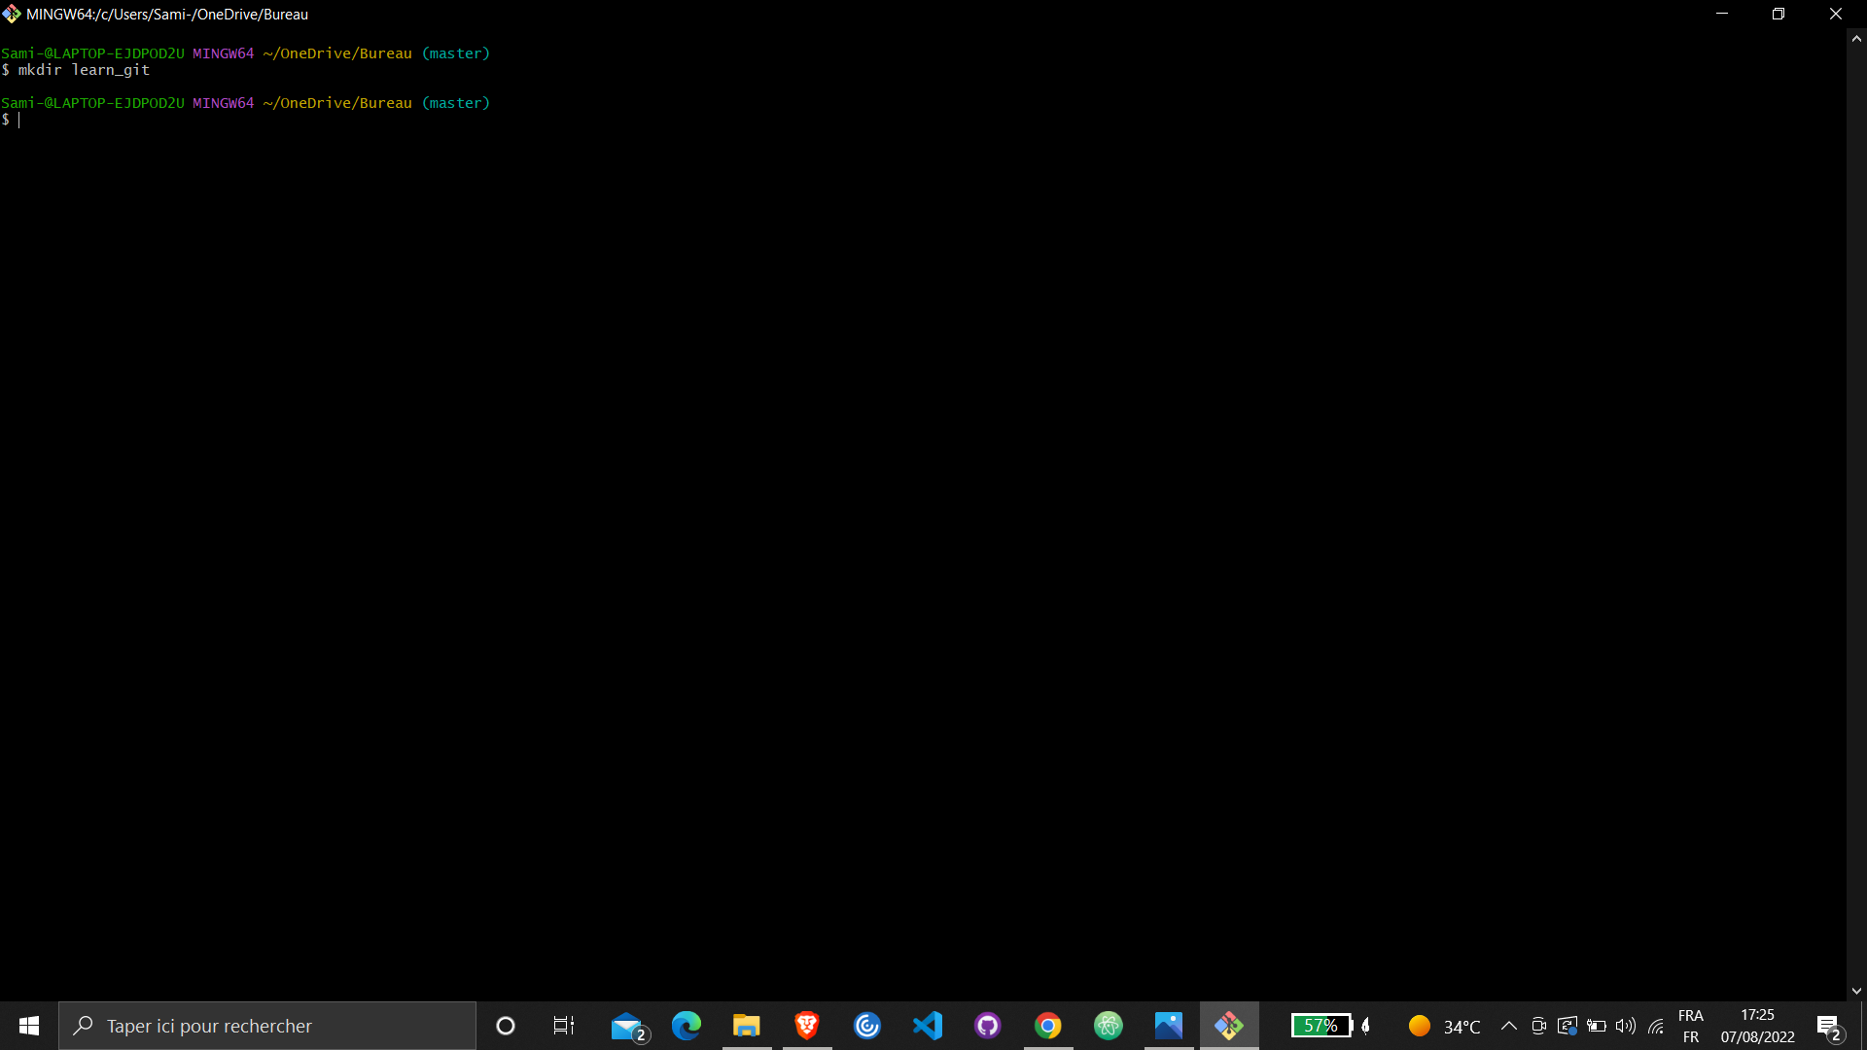
Create a folder called learn_git.

Slide 3
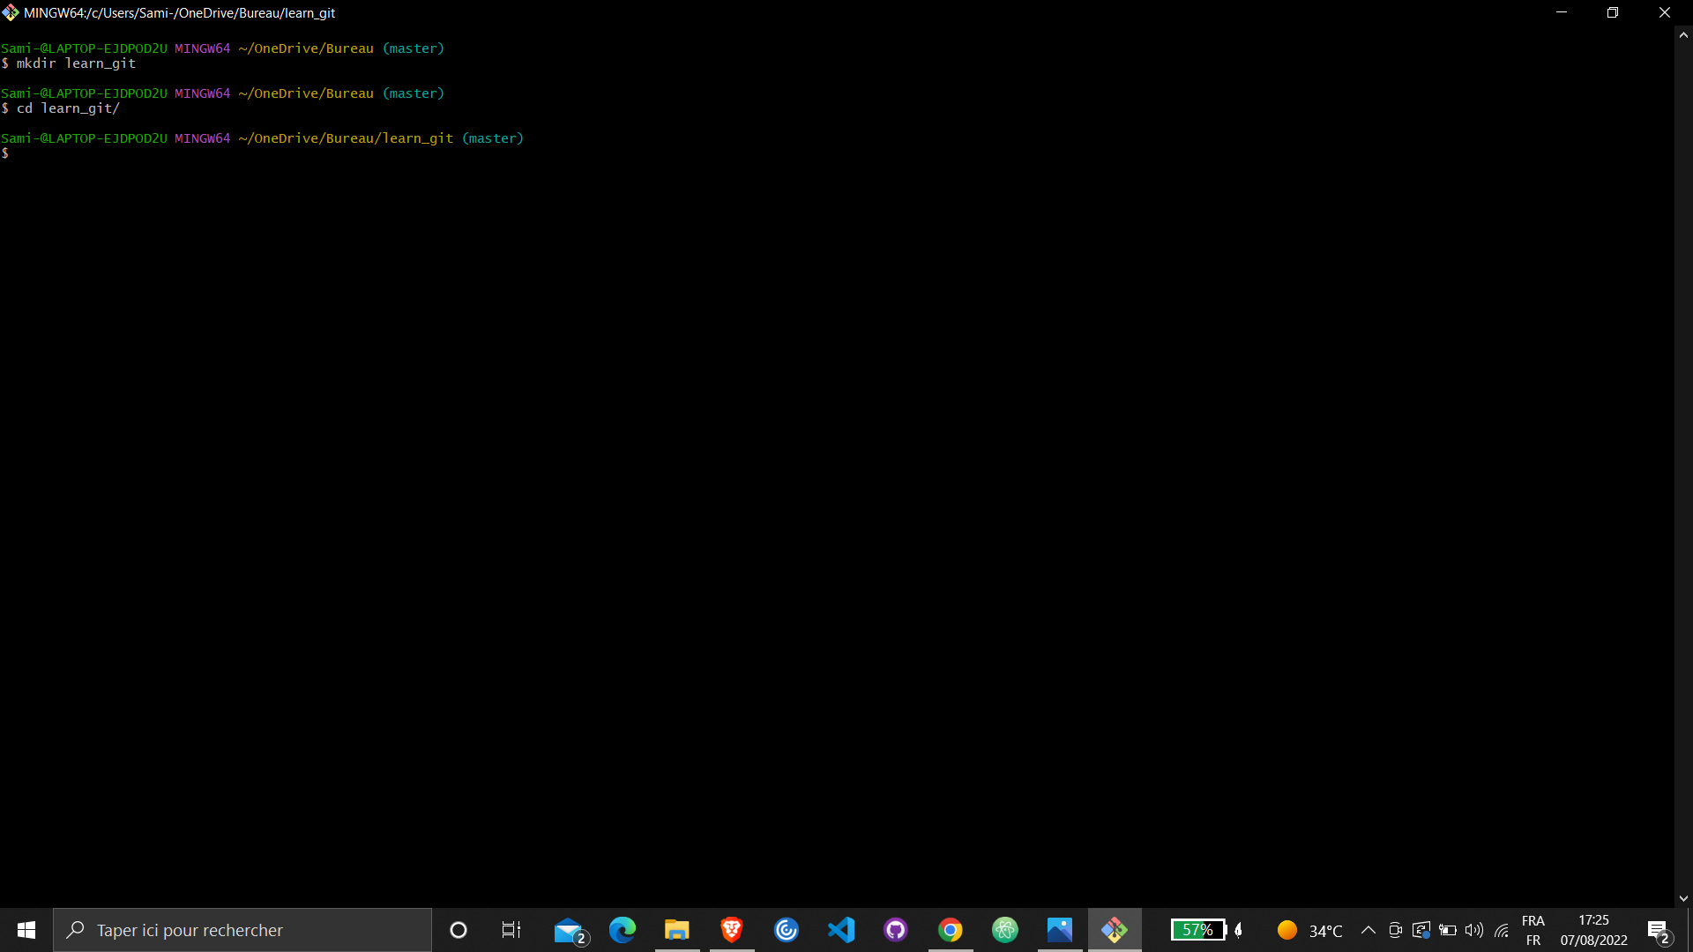
Cd (change directory) into the learn_git folder

Slide 4
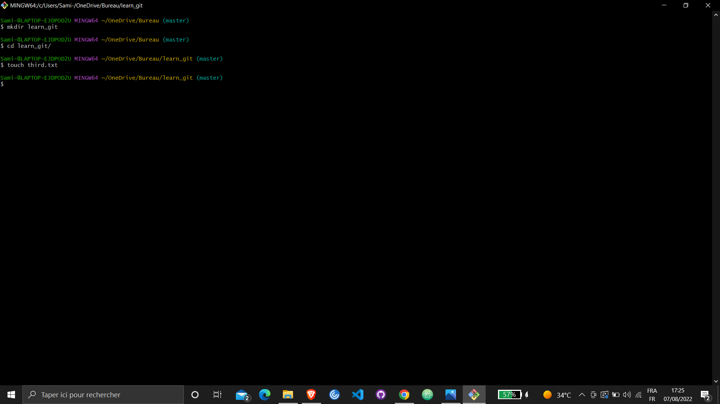
Create a file called third.txt.

Slide 5
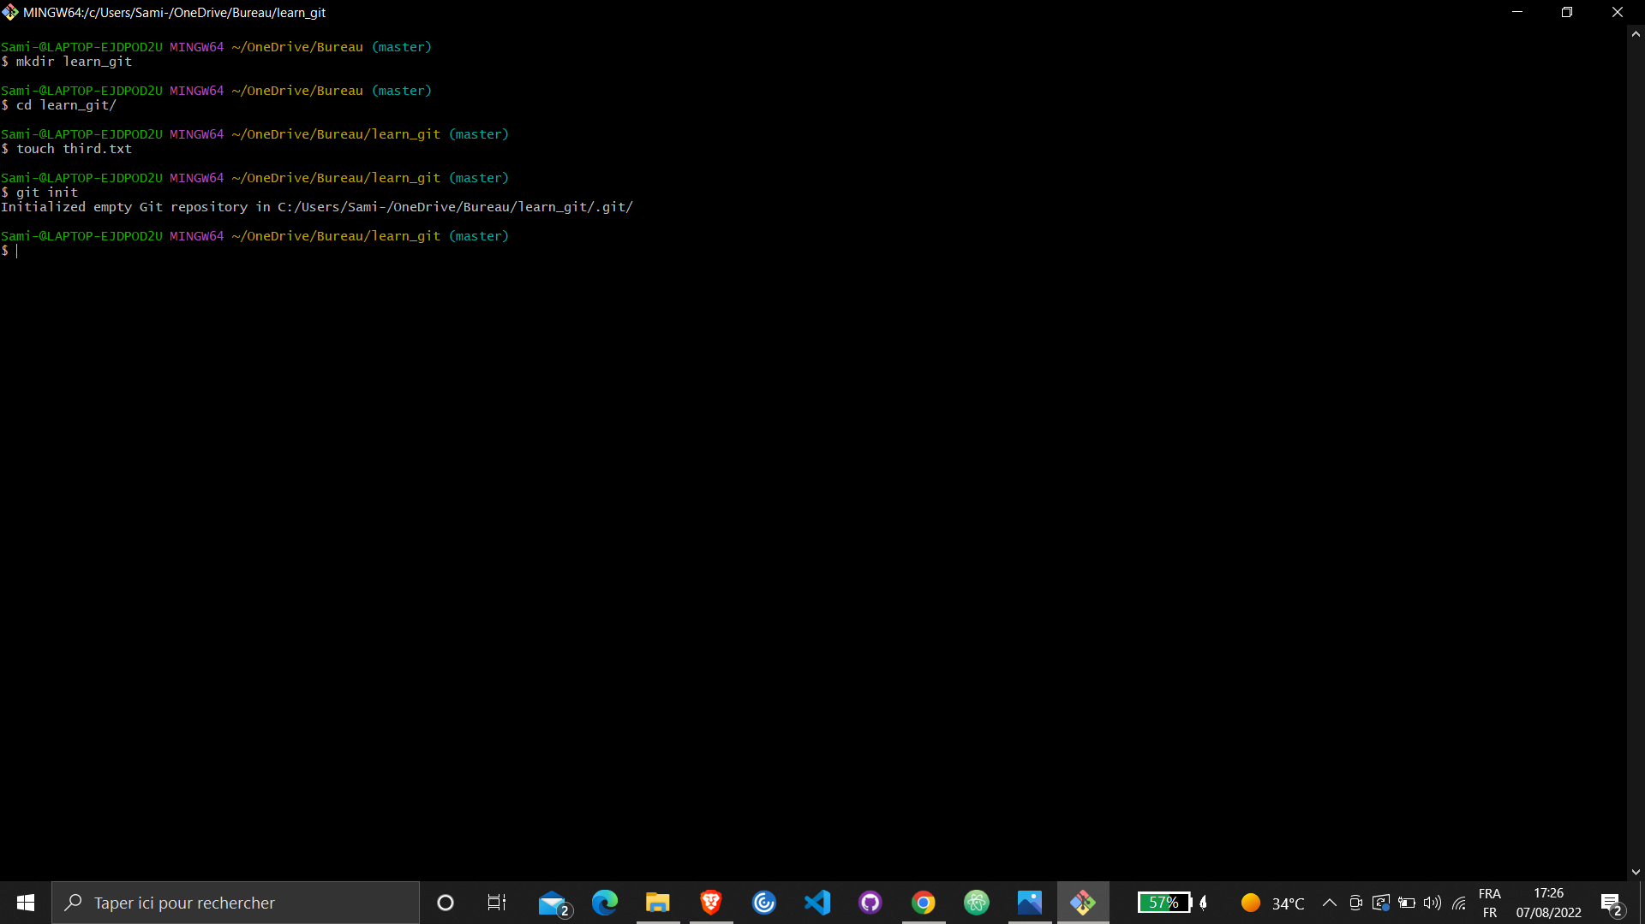
Initialize an empty git repository.

Slide 6
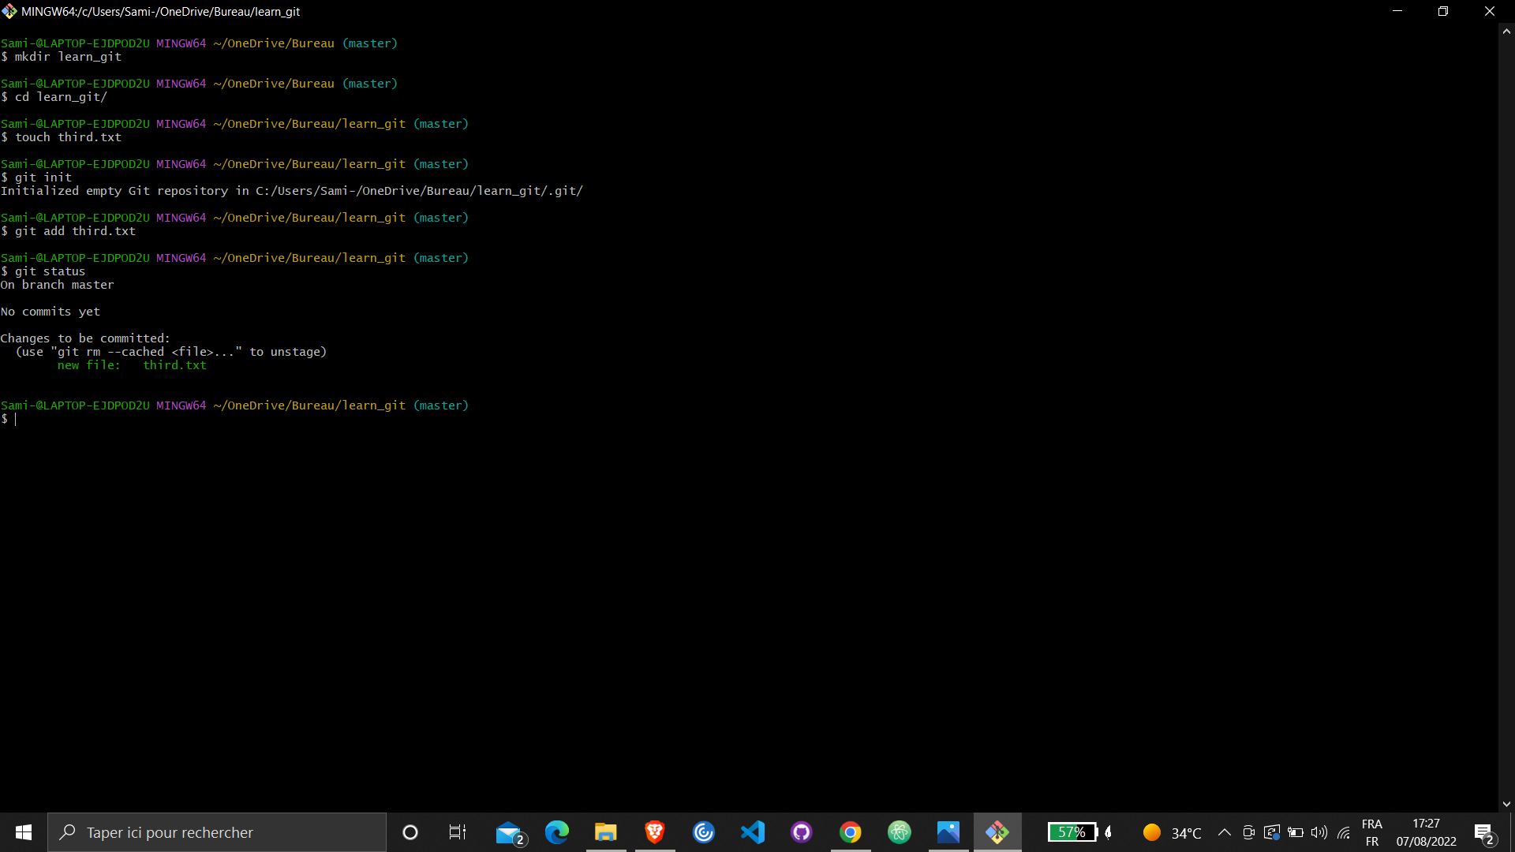
Add third.txt to the staging area. Used git status for checking.

Slide 7
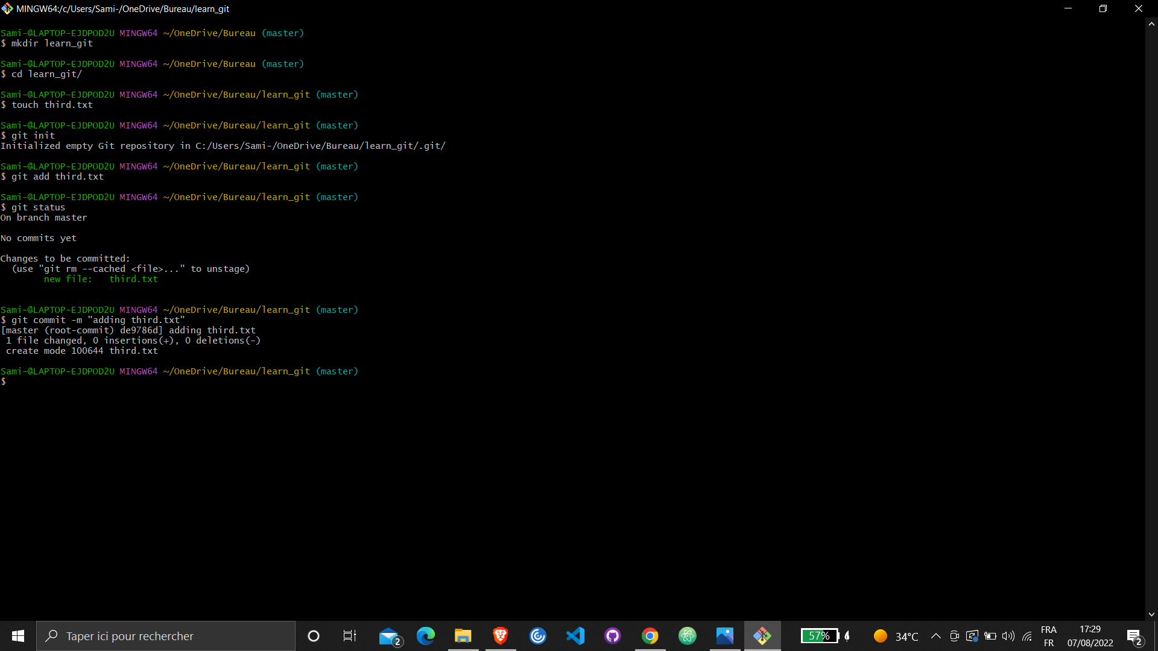
Commit with the message "adding third.txt".

Slide 8
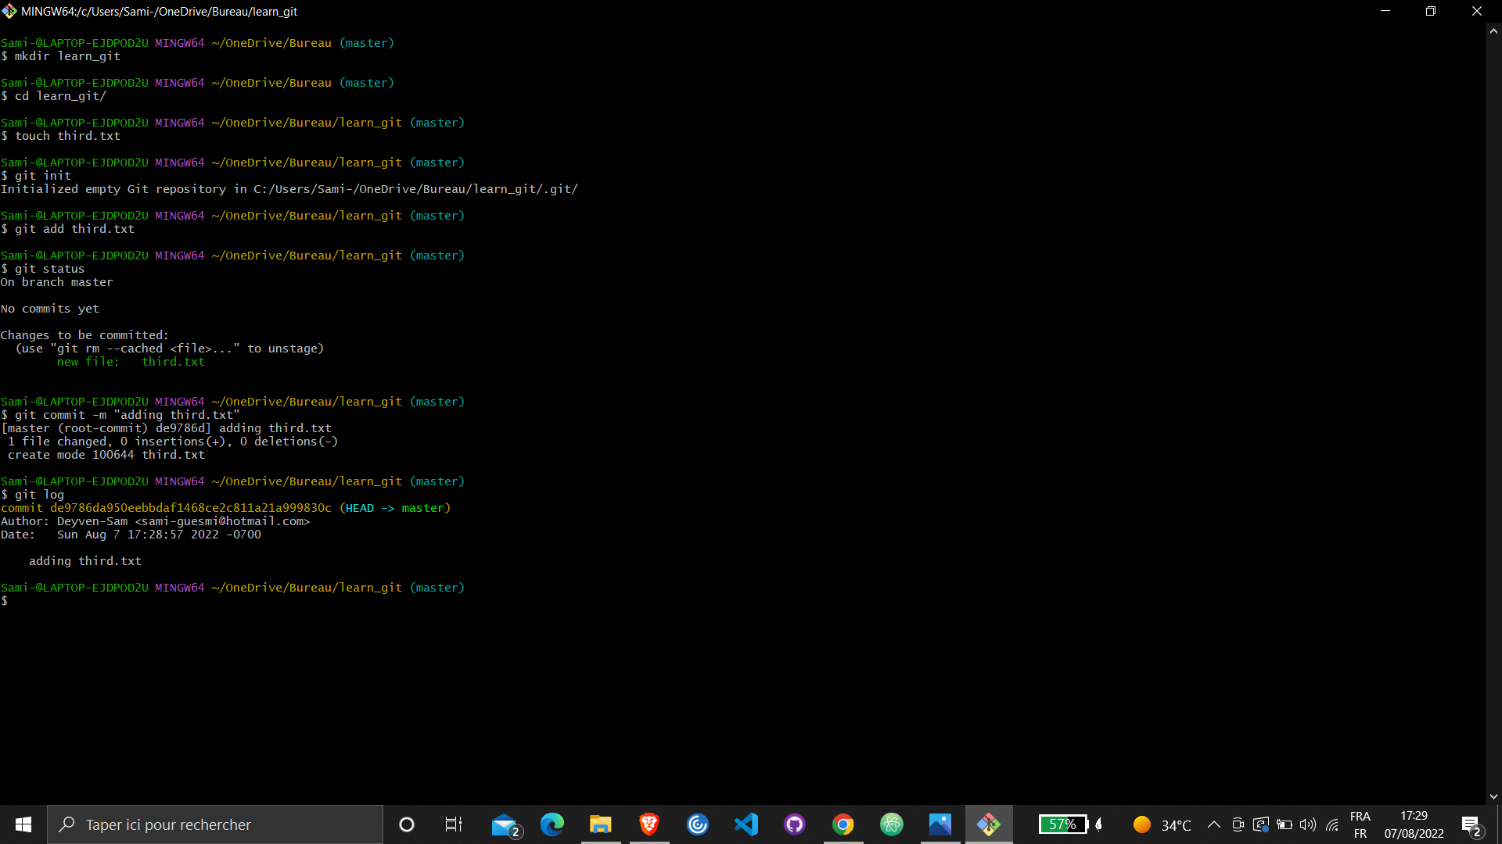
Check out your commit with git log.

Slide 9
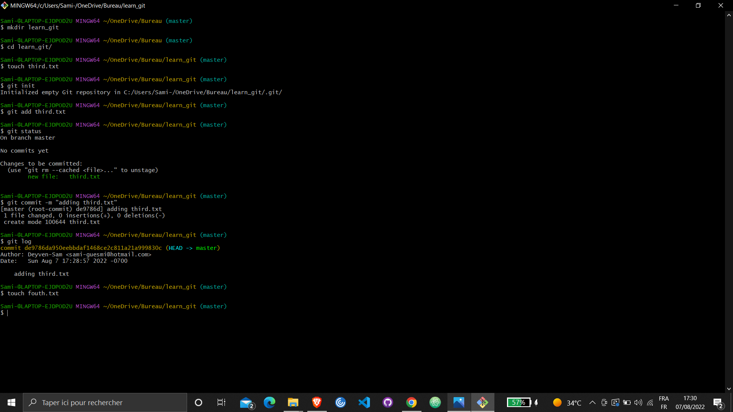
Create another file called fourth.txt.

Slide 10
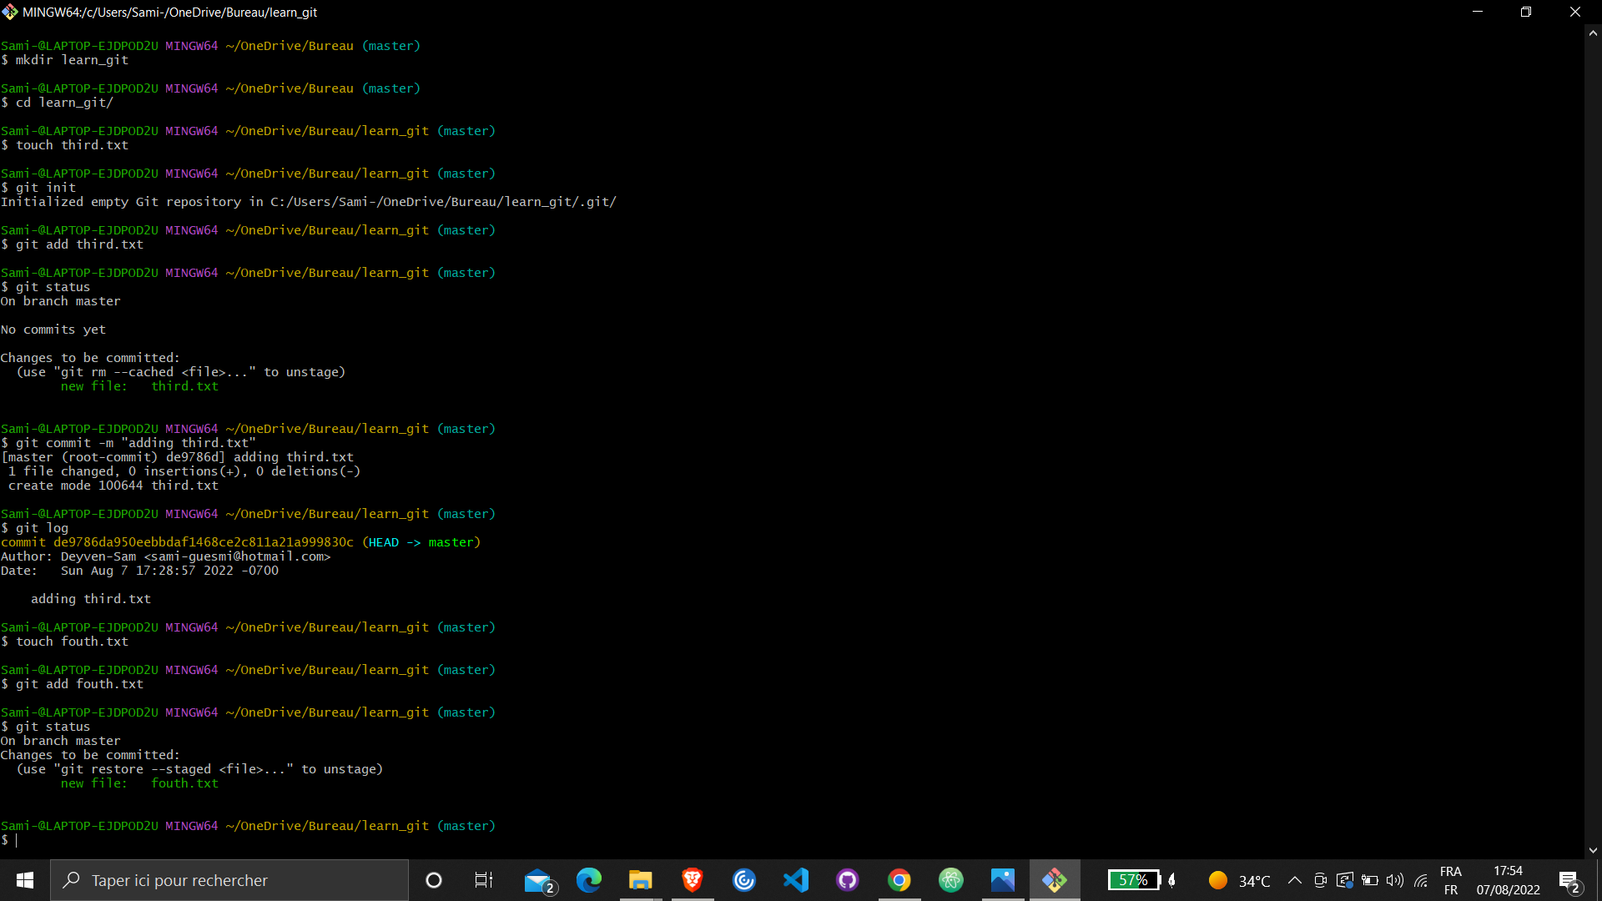
Add fourth.txt to the staging area. Used git status for checking.

Slide 11
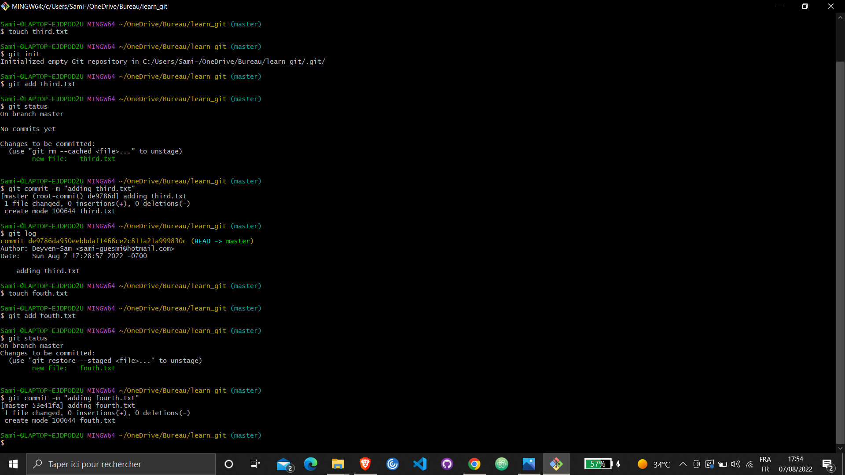
Commit with the message "adding fourth.txt"

Slide 12
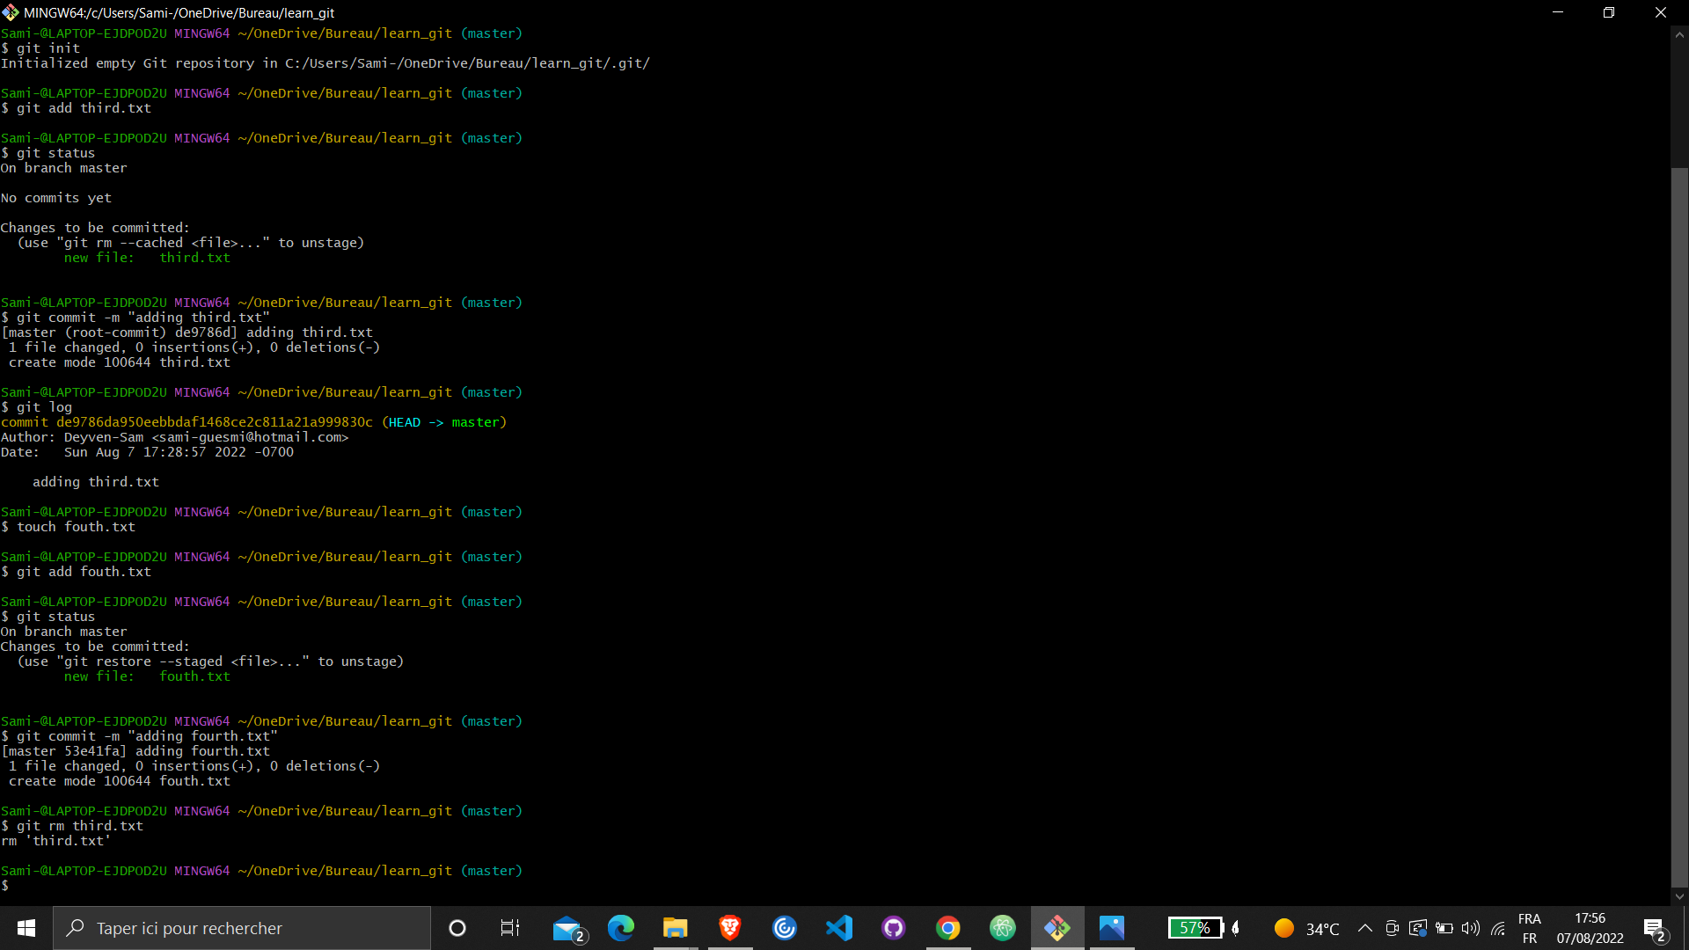
Remove the third.txt file.

Slide 13
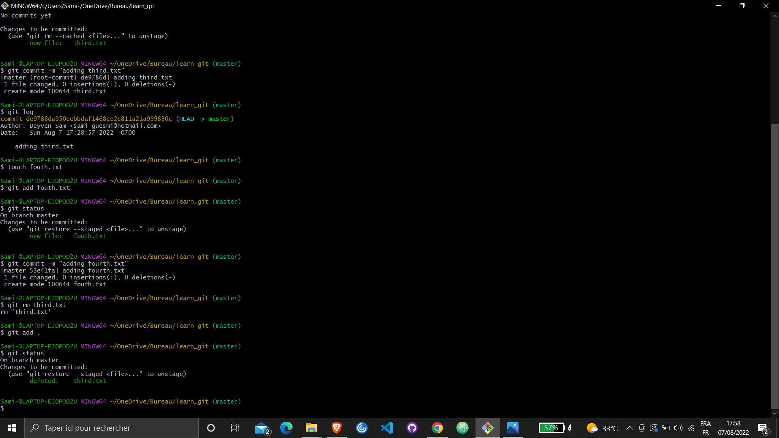
Add this change to the staging area. (Using the command "git add . " Used git status for checking.

Slide 14
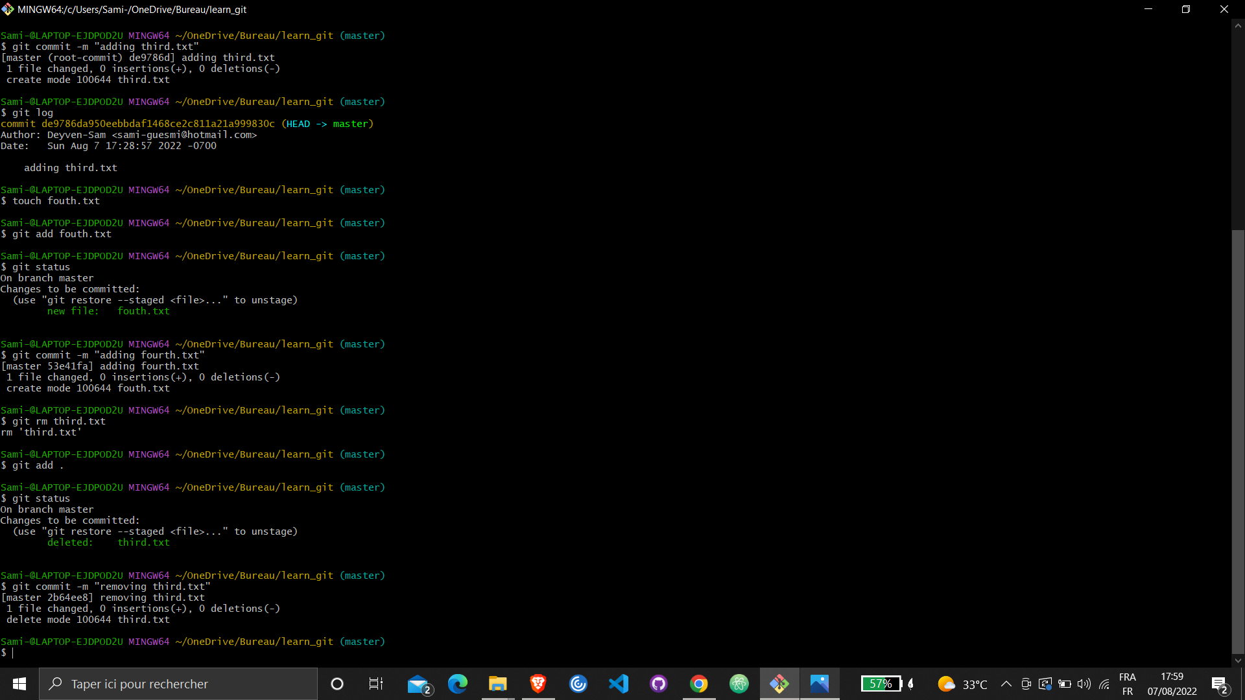
Commit with the message "removing third.txt".

Slide 15
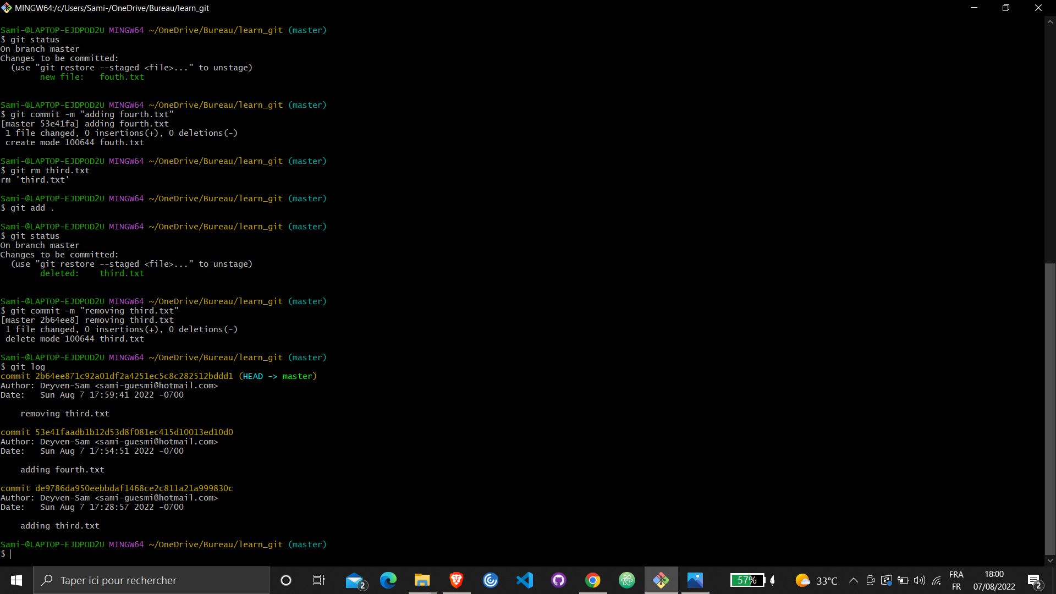
Check out your commits using git log.

Slide 16
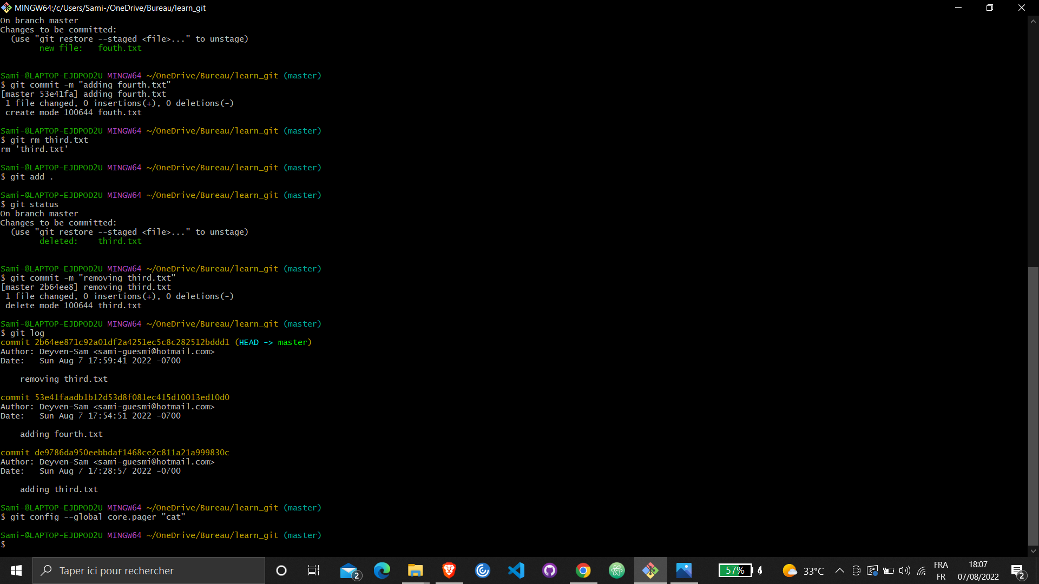
Change your global settings to core.pager=cat

Slide 17
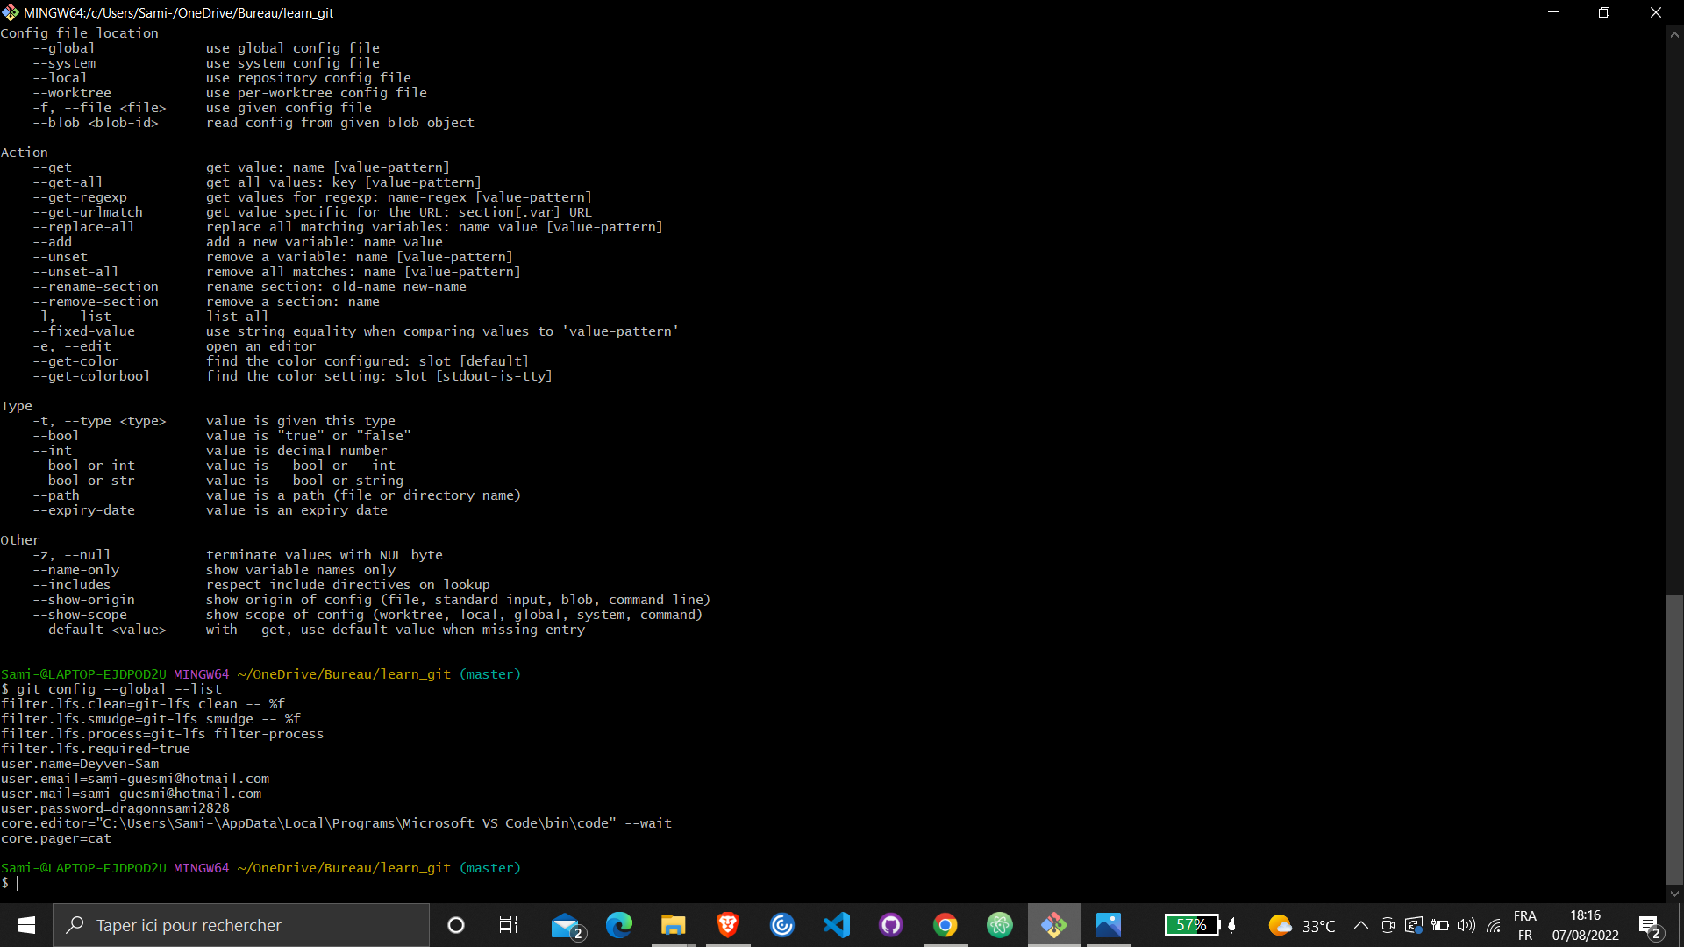
Write the appropriate command to list all the global configurations for git on your machine.

